Slide 1
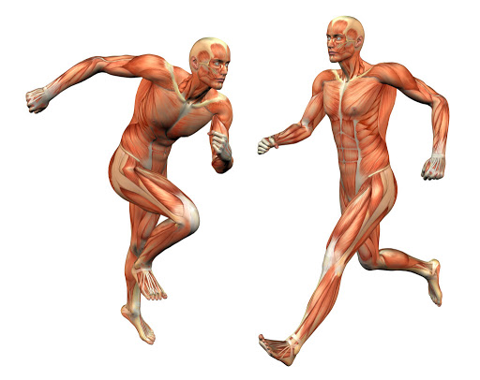
The Body and It’s Movements
Chapter: 9

Slide 2
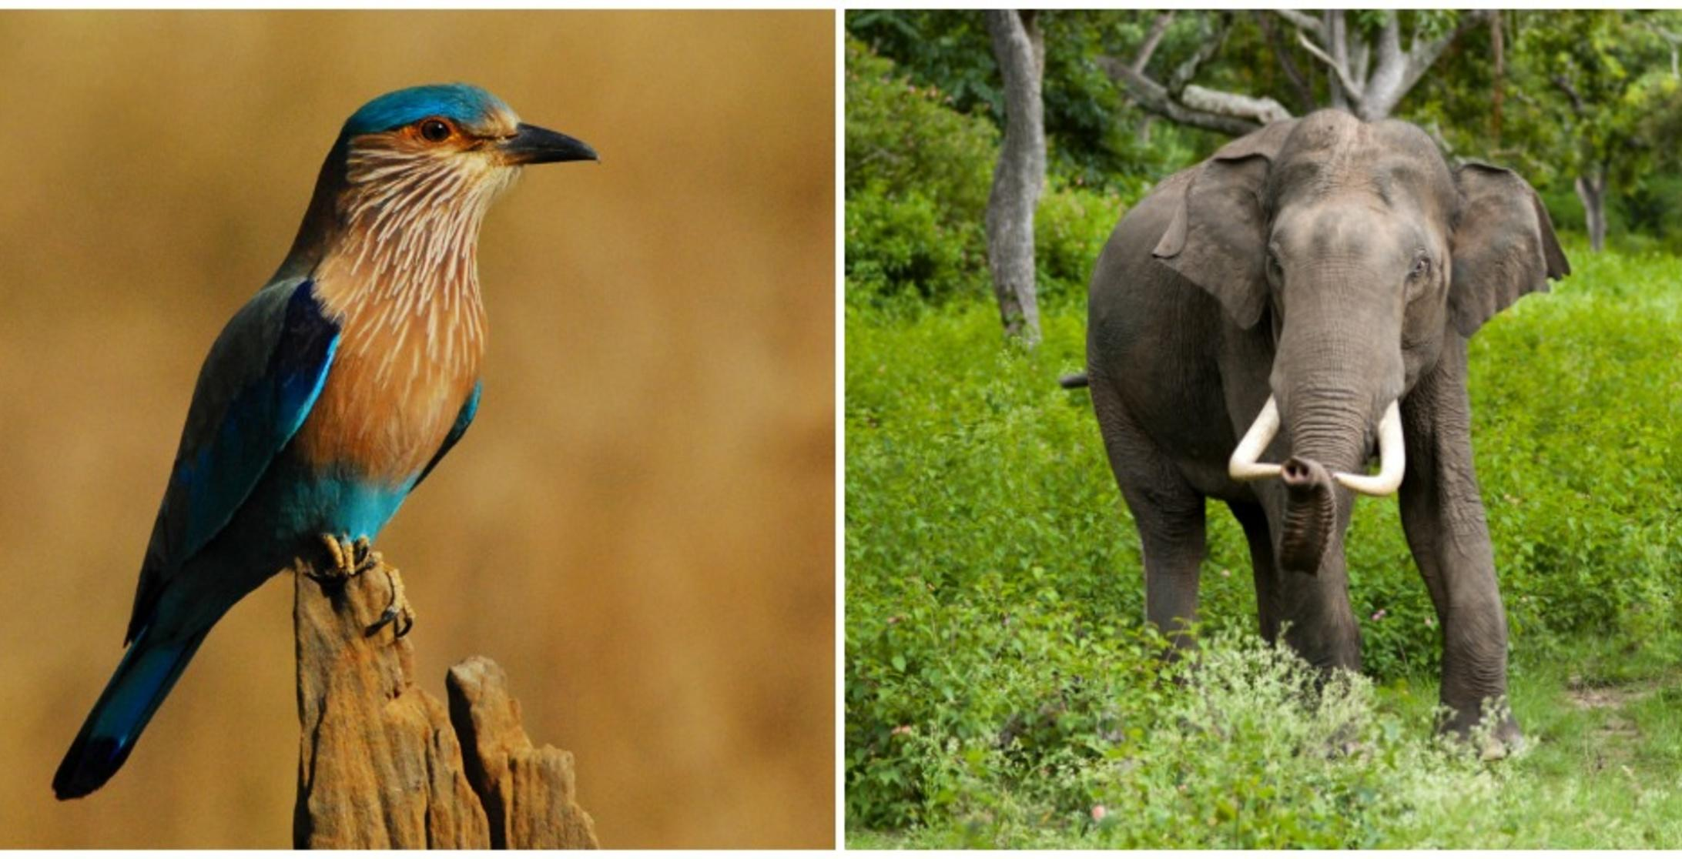
Reena is a small girl. One day her father took her to a zoo. Reena was really very excited to see the different animals and birds, she was very happy to see the crowd in the zoo. Suddenly she asked her father,” Dad why the animals are not able to stand straight like us and where are the hands for the birds?”

Slide 3
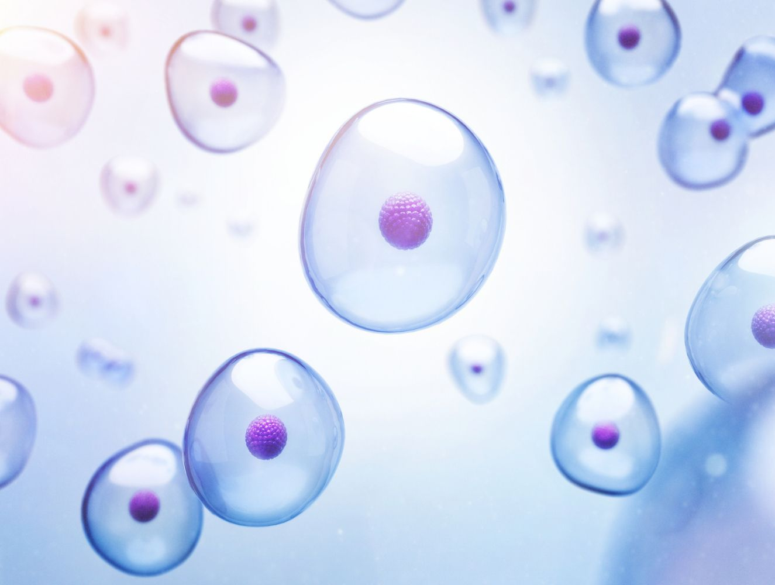
Organisation and structure of the body
Cell: The basic structural and functional unit or the building blocks of life
Unicellular Organisms : These are the living organisms that are made up of only one cell. Also called single-celled organisms.
Examples - Amoeba, yeast etc.
Multicellular organisms - These are the living organisms that consists of large number of cells
that constitute an organism
Example- Man, tree, mushroom etc.

Slide 4
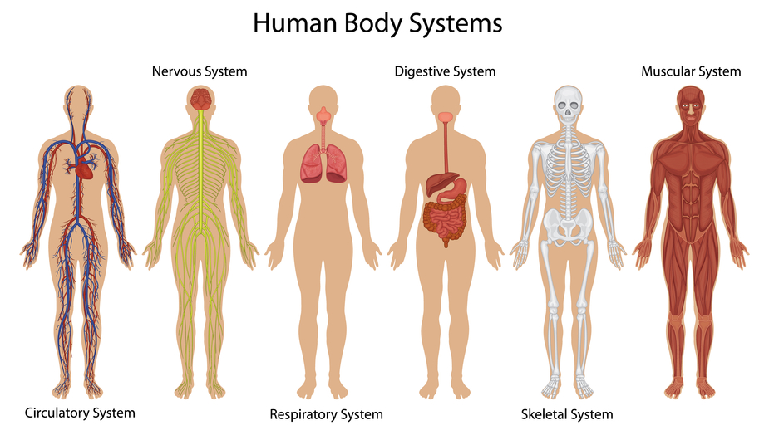
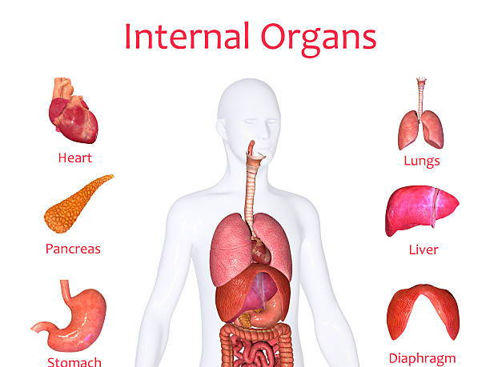
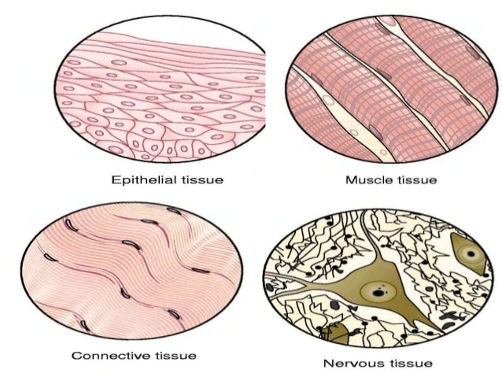
Tissues and organs
A group of cells that perform a specific job together is known as tissue
Example blood, bone, muscle,etc
Tissues combine to form an organ
Example heart, lungs,etc
Organ system: Different organs join to perform a specific task.
Example circulatory system, respiratory system

Slide 5
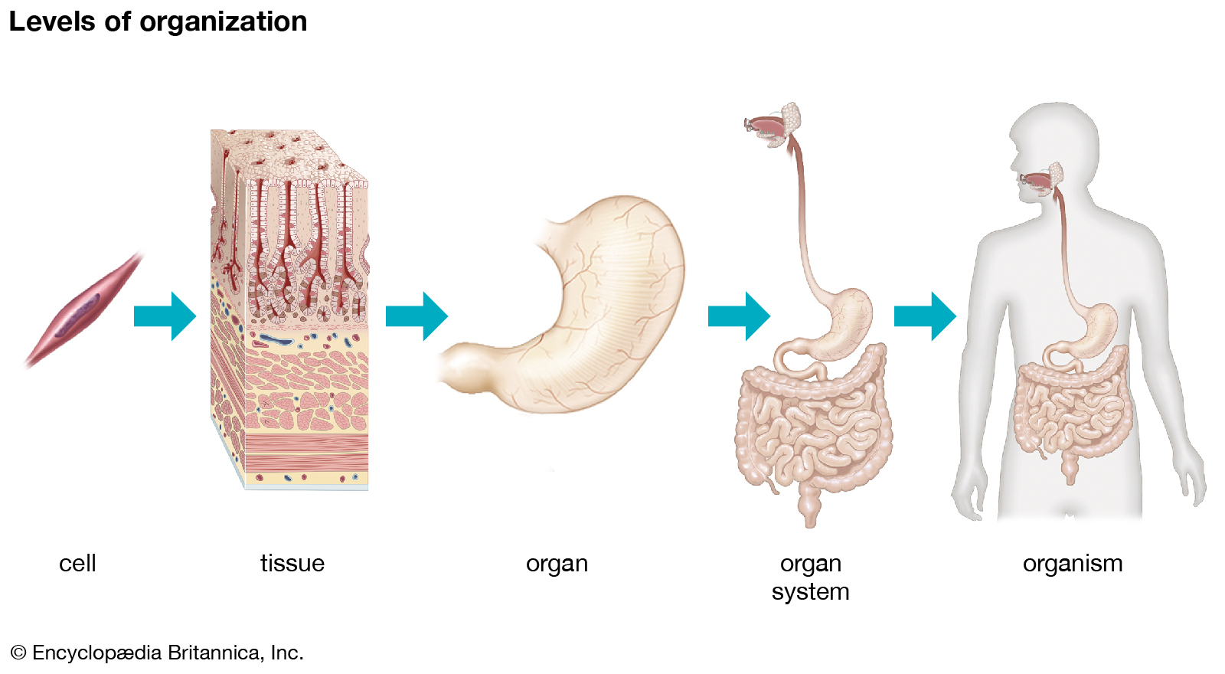
Cell to organism
All these systems work together forms our body.
All these organs work to keep us alive.
All the multicellular organisms are organised as shown.

Slide 6
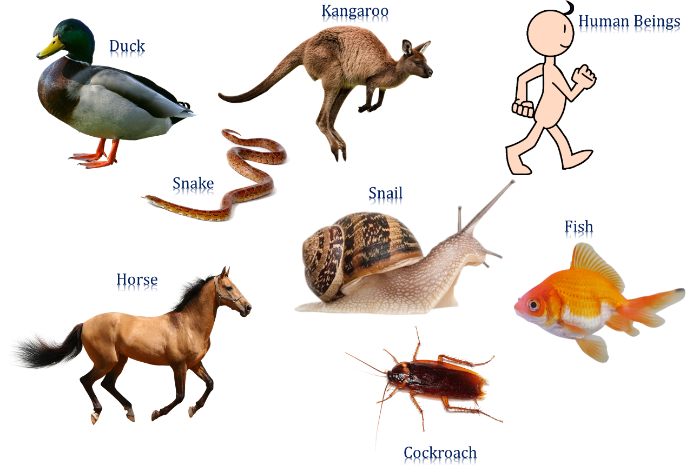
Movement
All organisms move by different means,

Slide 7
Human skeletal system
The bones in our body make up a framework called the skeleton.
Adult have 206 bones where as the child has more than that , these bones fuse together and become 206.
Functions of skeleton
Support: The bones form a framework to support otherwise the body may collapse.
Protection: They protect the soft organs in our body like the heart, lungs, brain, etc.
Movement: The bones are very hard and are able to individual movements like the walking, movement of hand and arms, etc
Making blood cells: The bone are hard outside but soft inside called as the bone marrow which produces the blood cells.

Slide 8
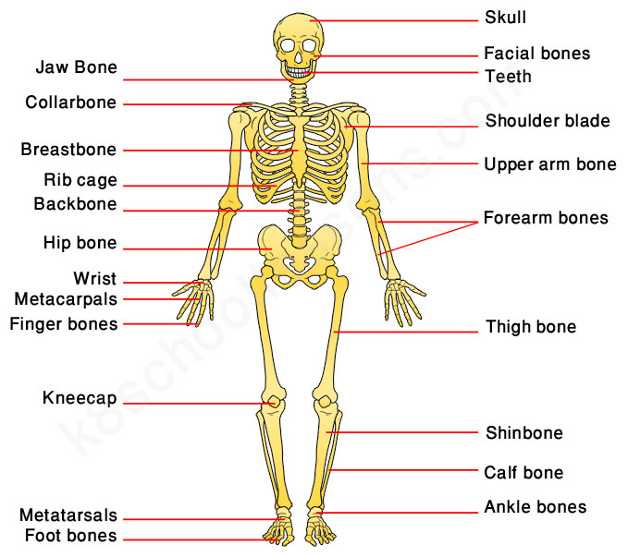
Structure of the Human skeleton
Human skeleton system has basic 4 parts
The skull
The backbone or spine,
The ribs
The limbs

Slide 9
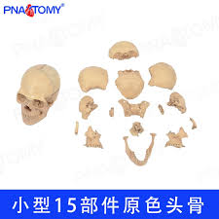
The skull
The bone that protects our brain
It has holes for eyes, nose mouth and ears.
The upper part is made of 8 flat bones joints together
The face and jaws contain 14 bones
The teeth are fixed to the jaw bone(upper and lower jaw bone)
The lower jaw bone is the only bone in the skull that can move
It helps us to chew the food and eat.

Slide 10
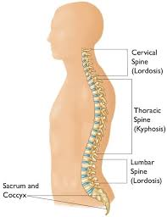
The backbone or spine
Spine is made 33 of small bones called vertebrae
These bones are joined to each other and allow slight movement (bend and twist)
They are attached to the base of the brain and forms the central supporting rod for the skeleton
Each vertebrae has a small hole in it through which the delicate organ Spine cord passes through it.
Thus the vertebrae or the backbone protects the spinal cord
Thus the backbone is also called the spine or the vertebral column

Slide 11
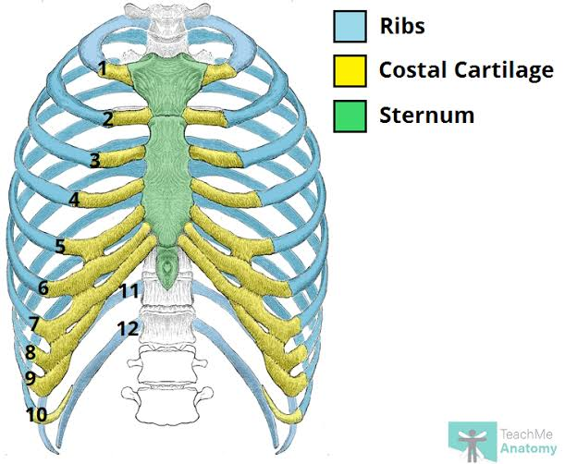
The rib cage
The bone in the chest is called the rib cage
They are thin, flat and curved in structure and protects the upper part organs like the heart ,lungs, stomach and kidneys
Totally there are 24 bones arranged in 12 pairs
All these bones are joined to the backbone at the back
Most of them are joined to the breast bone in the front except the last 2 pairs of the rib cage socalled floating bones as they are not attached to the breast bone.

Slide 12
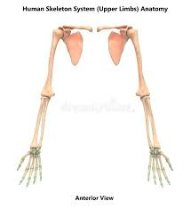
The limbs
In 206 bones in total most of the bones are present in the hands, wrist, feet and ankles
The longest bone of our body is the thigh bone called the femur and the lower part of the leg long shin bone called the calf bone
The ankle and the feet are made of number of small bones
The femur is attached to the hip by the hip joint
The upper arm has long bones called the humerus
The lower arm has the 2 long bones
The wrist and the fingers are made of several small bones
The humerus is attached to the vertebral column through the collar bone and the shoulder blade

Slide 13
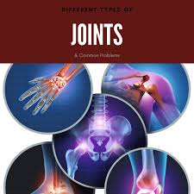
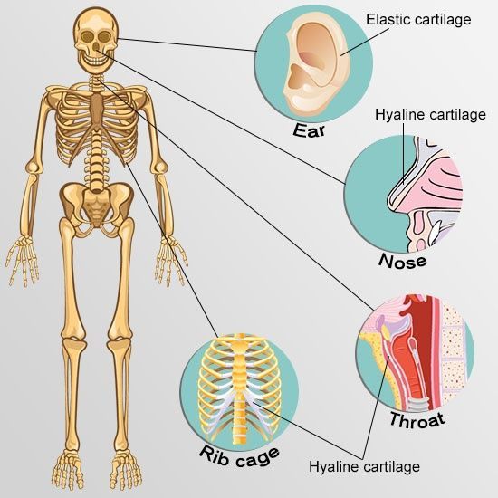
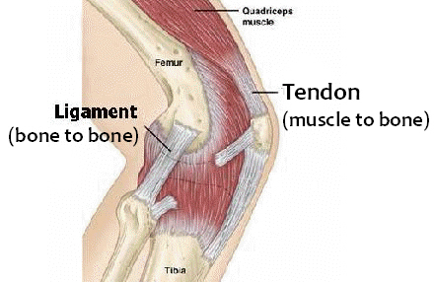
Joints, Cartilage and Ligaments
The place where two bones meet is called the Joints, they can withstand jerks
The end of bones have a soft coverings called the Cartilage, act as the shock absorber and reduces frictions between bones
Cartilage are in some parts of body but not hard as the bones
Example upper part of the ears
The bones are held together at a joint by strong, stretchy band called the Ligaments

Slide 14
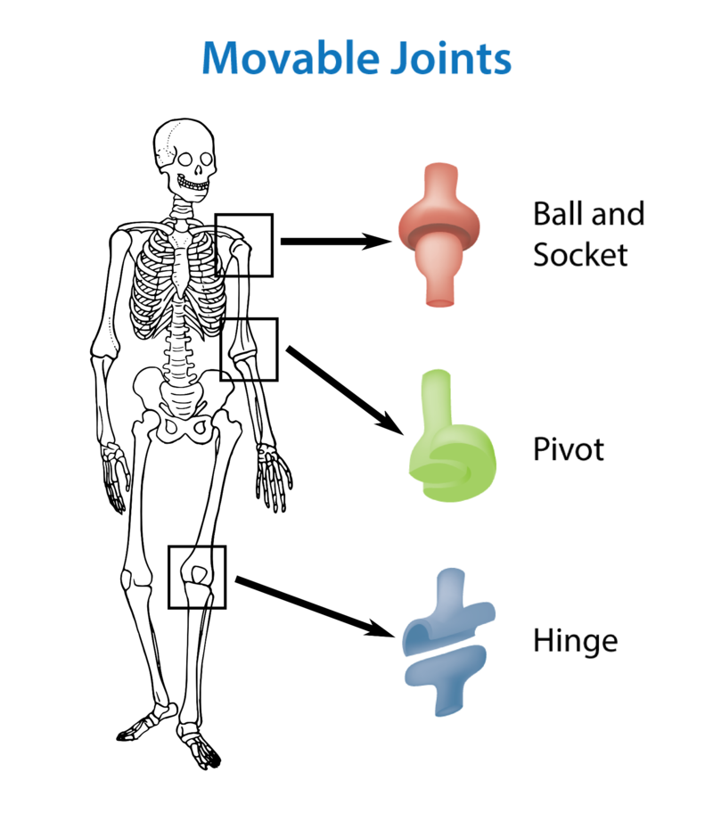
Joints and their types
Joint are of three types depending on their movement –
Immovable – skull
Slightly moveable – ribs
Freely moveable – limbs – they are of four types
A) Hinge joint – the elbow, knee, finger joint
B) Ball and Socket joint – shoulder and hip joint
C) Pivot joint – the neck
D) Gliding joint – wrist and ankle joint

Slide 15
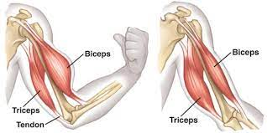
What makes the bones move?
Bones don’t move by themselves, they are attached by the muscles that help them move
Muscles are like elastic bands connected to the bones by tough connecting bands called the tendons
Normally two muscles are needed for the movement of a bone
Example you wanted to lift up your arm there are muscles acting they are the biceps and the triceps
The biceps contract when u lift your hand up
The triceps contracts when you put your hand down.

Slide 16
Movements of other Animals
https://youtu.be/C5m9BaQsn-Y

